Slide 1
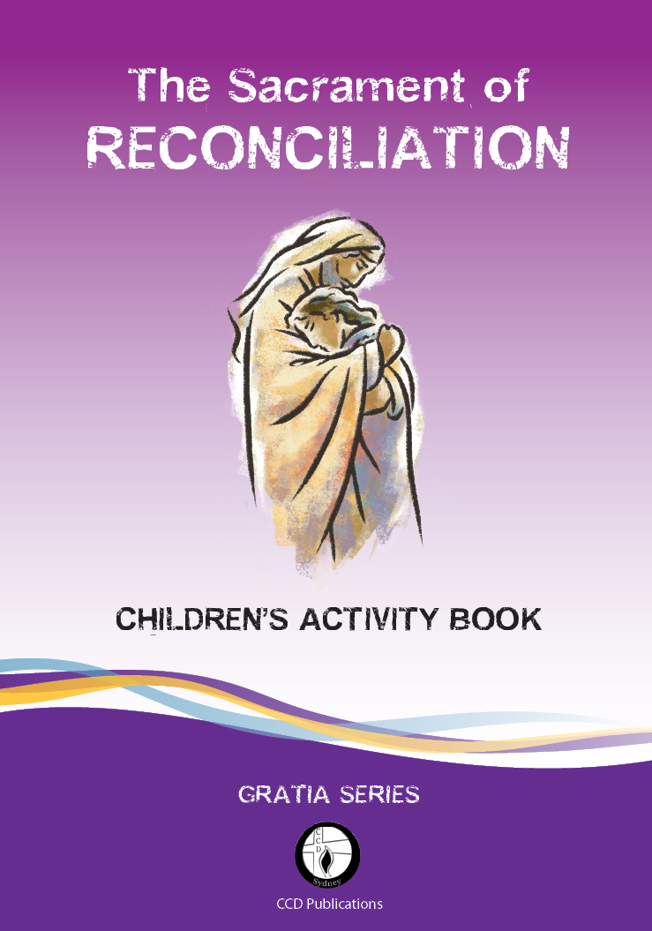
Session 1 Contents
Step 1: For Parents
Before starting | Parent notes
Step 2: For Parents and Children
Session 1 “Making Choices”

Slide 2
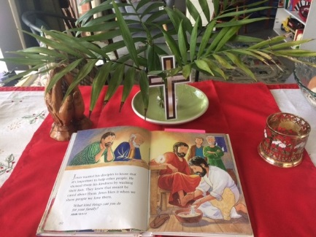
For Parents - before starting
On each slide you will see an audio icon
Hover your mouse or pointer over this audio icon – click play to listen now:
Each session begins with a brief talk just for parents.
We want you to be able to help your child to understand each session and how it applies to your child.
We suggest you set up a Prayer Place to make it easier to focus.
See the photo here [on the right]
This prayer place has a:
Cloth
Candle
Cross
Bible
Palm fronds
Notes:
This Reconciliation program has four sessions. Each child should have an activity book and a pencil to write responses. The sacrament of reconciliation is a celebration. What are we celebrating? Certainly not celebrating the bad choices that your child has made. We are celebrating that your child is able to discern and admit they have done something wrong and that they need to ask to be forgiven.

Slide 3
Bits at the Back of the Book
Glossary page 51
Prayers page 47
Examination of Conscience page 45
Reconciliation Booklet page 44
Notes:
It is a shame if people only find these bits when all the sessions are completed. Take a little time to have a look at the Activity Book. Turn to the glossary on p 51. here you can see definitions of words used in this program. On page p 47 are the prayers your child would know from lessons at school. The examination of conscience on p.45, 46 is based on the 10 commandments with questions that are at an age appropriate level for your child. On p. 43, 44 There is a removable ‘’Reconciliation Booklet’- a handy reference for your child to take with them when they go to Reconciliation (Confession). On page 42 you will see the Golden rule we refer to during session one.
.

Slide 4
Parent notes
Turn to pages 11-12
and listen to this overview:
To Remember
Your child has freewill.
You cannot choose for them.
How can you help them to recognise choices based on love and those not based on love?
This is what this session is about – we will start with what your child already knows about life and then use activities, stories and discussions to look at real life examples.
Notes:
In an ideal world this page should be read before the start of each session. The ‘parent notes’ for this session will help you, as the first educators in faith for your child, to understand the connection between free will and good v’s bad moral choices. Children go through stages of moral development, yet unlike physical growth, moral growth doesn’t happen without some input from parents. From infancy to adulthood the developing moral person progresses from self (“It’s right because it feels right to me”) to others (“It’s right because it’s what we do in our family”) to abstract moral reasoning (“It’s right because it is right”). To develop into a morally responsible person, a child must be given a solid foundation at each stage.

Slide 5
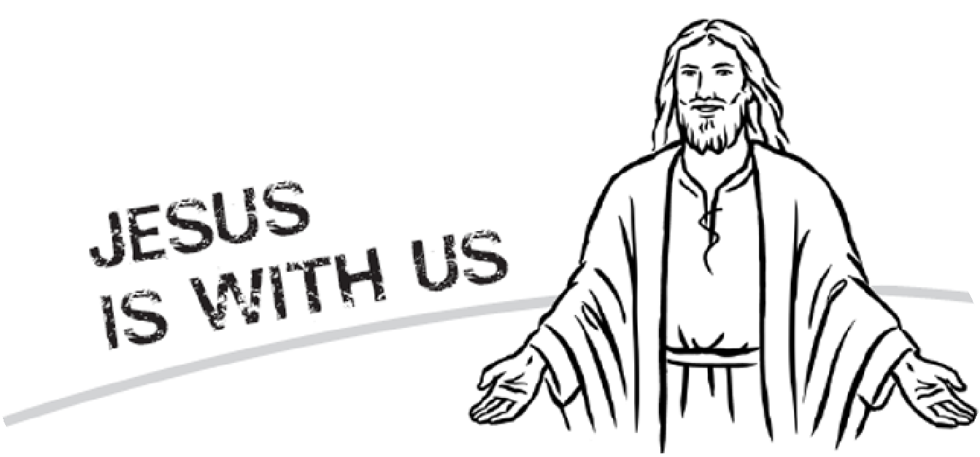
For parents and children Welcome
To hear what we will do, click play:
On the next slide we will begin with prayer
Notes:
Welcome parents and children to your Reconciliation Program.
Each session starts and ends with prayer. This session is about choices – and discerning if they were good choices or bad choices. It should take up to 50 minutes. Parent and child will be seated together so you can discuss the topic and help each other with the answers. There should be enough time for the written exercises to be completed during the session. Now let’s get started with our prayer.

Slide 6
Praying together
Turn to page 4
Together, we pray . . .
Praying helps us to be present right now to God who is with us here and always.
We can’t see God at the moment, just like we cannot see love, but love is real, and God is real. God gives us life and wants us to choose life everlasting.
Notes:
If this is a small group session with an advertised starting time it is best to start on time or as near as possible. If you delay the start it is unfair to the families who arrive on time and it encourages the late comers to be late. If it is a family session at home turn off all distractions and give your total attention to this precious child.

Slide 7
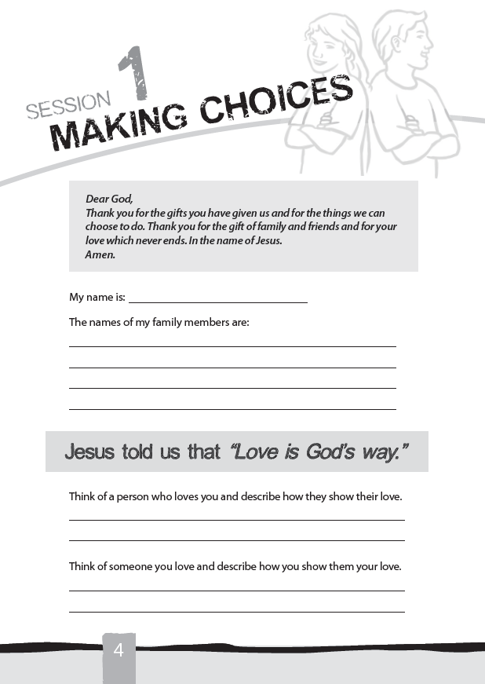
GOD IS LOVE
God is love. This is what is taught in your child’s religion/scripture lessons in school. All God ever asks us to do is based on love.
Any child would find it difficult to make a choice based on love if they had never experienced love.
This exercise allows your child to discuss with you how they know they are loved.
Notes:
Your book should be open at page 4. You will find 2 exercises there for the children to complete. The first one my name is… when he/she has finished this ask your child to read the statement -Jesus told us that ‘Love is God’s way’ and start the second exercise. Parents you now get an opportunity to hear about love from your child’s point of view. Sometimes the responses to these questions will surprise you. If this is a group setting, the children may be willing to share their answers.

Slide 8
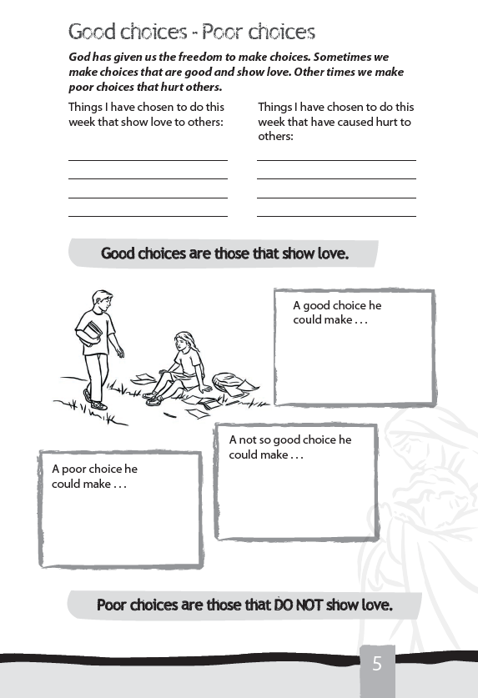
What would you do if……..
As parents you watch as your child learns to walk, talk and to make choices.
A choice based on love. Listen as your child tells you when they were kind, helpful, obedient this week.
A choice that did not show love.
Parents – you must know some of the poor choices your child has made. Do not make a list of suggestions. Try to help them remember one of these times.
The moral dilemma at the bottom of page 5 allows your child to critic someone else’s actions. This is easier than discussing their own poor choices.
Notes:
when did your child first smile, what was their first word, when did they start to walk. When did They start to talk. These milestones are often recorded in their baby book. What about their moral development milestones. How can you asses their moral reasoning.
An infant does not have the capacity to moralize, other than having a sense of rightness or wrongness as those feelings apply to himself. By eighteen months a sense of “otherness” begins. Toddlers learn that others share their world; others have needs and rights, too. The house they live in has “rules” that they must learn to live by, which is frustrating. They show their use of free will by that often heard word ‘NO’ This age child does not yet have the ability to judge something as “right” or “wrong”; they are only directed by what others tell them, which competes with their internal drive to do what they want.
As they get to age 7 - 10 their choices start to take into account another person’s feeling.

Slide 9
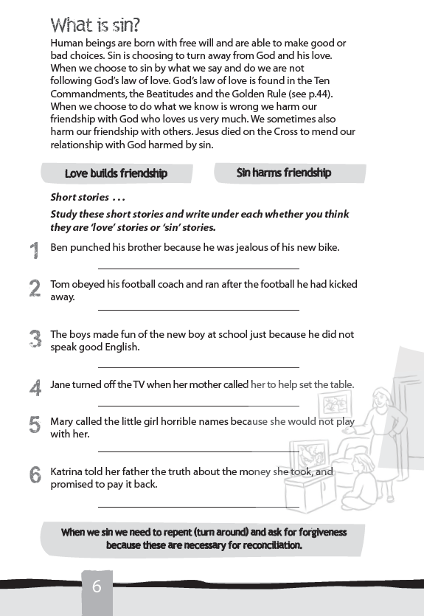
WHAT IS SIN
Is it breaking rules (I will get into trouble) or harming relationships (I have hurt someone).
In the short stories on page 6 your child will know the good choice (love) and poor choice(Sin).
Discuss each question with your child. Ask them why they decided on each answer.
Notes:
As a parent you have helped your child begin to understand the concept of the Golden Rule, to consider what they do and how it affects other people, that others have rights and viewpoints, too, and how to be considerate. They perceive consequences and can grasp the when-then connection: when I misbehave, then this happens. In helping your child understand the concept of sin do not to associate every snap decision your child makes with sin. Sin is an attitude which is expressed in an outward action.

Slide 10
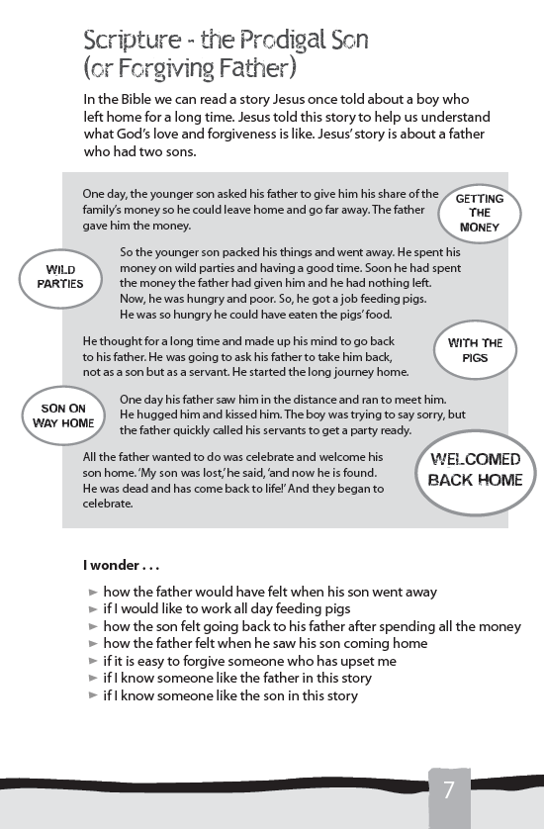
Forgiving Father
The Prodigal Son is a beautiful and familiar parable of forgiveness.
The younger son squanders his family inheritance and yet the father welcomes him back into the family as if nothing has happened.
I wonder … there usually is no right or wrong answer to these type of questions. They help you and your child explore the parable, evoke wonder and relate the story to your life experience.
Notes:
We now turn to the scriptures. What did Jesus have to say about forgiving people who hurt others by their poor choices. Instead of a lecture on sin and forgiveness Jesus told a story. A most unbelievable story for the people who first heard it. Take time to read and explore this parable with your child. Wonder together – share with each other what you imagine each character felt as the story progresses.

Slide 11
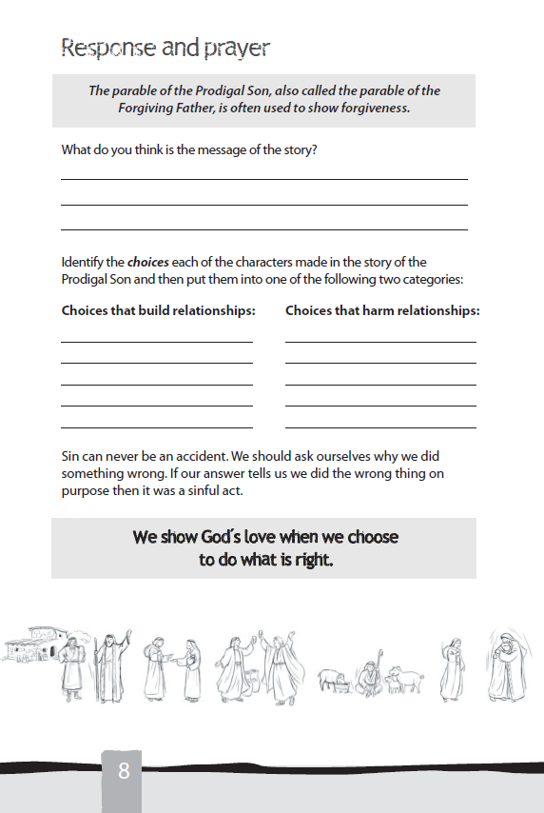
Exploring the scripture text
Our choices and decisions affect others and ourselves.
Help your child find each of the choices made by the father and the son in Jesus parable. Help them see how each choice and decision affected both of them.
Sin can never be an accident.
Notes:
Together with your child find the choices made by both father and son in the parable on p. 7. Discuss how each choice either strengthened the relationship between father and son or harmed their relationship. Your child may focus on different aspects of this parable. Some parts may relate more to their experience or understanding than others. Help your child list the choices under the two headings on p.8.
Human beings are born with the grace of free will and therefore have the capacity to sin. Sin is the breaking of relationship, the turning away from God. It is important that your child hears that sin can never be accidental.

Slide 12
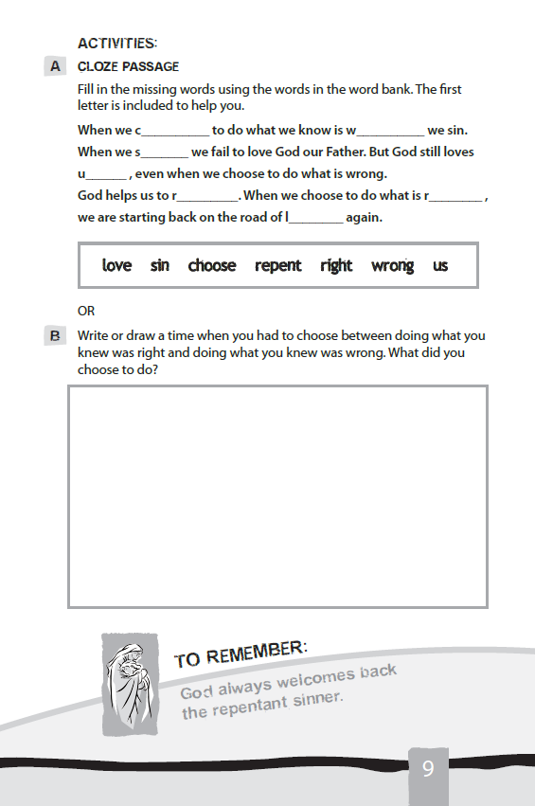
ACTIVITIES
Cloze passage on page 9 sums up this session. When it is completed ask your child to read it.
The second activity is more challenging. Your child may choose an example of when they choose to do what they knew was right. Ask them why they made this choice. Their answer will be either because they will get into trouble or because it will hurt someone else. This will help you asses their moral reasoning.
Notes:
A major turning point in moral development occurs when the child begins to internalize family values. What’s important to their parents becomes important to them. Children behave well because they have had several years of positive parental direction. Without this parental direction children may operate from the basis of “Whatever I do is okay as long as I don’t get caught.”
Seven-to-ten-year-olds have a strong sense of fairness and understand the necessity of rules. Have you ever seen an under 5 soccer team at a game. All the players are bunched together with each child following the only rule they really understand ‘kick the ball’. Coaches are outside this swarm yelling spread out spread out. However both teams ignore this plea as they try to get a goal – often into the ‘wrong’ goal. By the age of 7 – 10 the players in a team are able to hold position for the sake of the team. They are willing to pass the ball to other team members. This is a good indication of their moral development.

Slide 13
Family Prayer
Each session begins and ends with prayer. This prayer could be used as a family prayer during the week.
Jesus told us to love one another and when we do not do this we sin.
The To Remember on page 10 has five statements about sin to help you focus on what was taught.

Slide 14
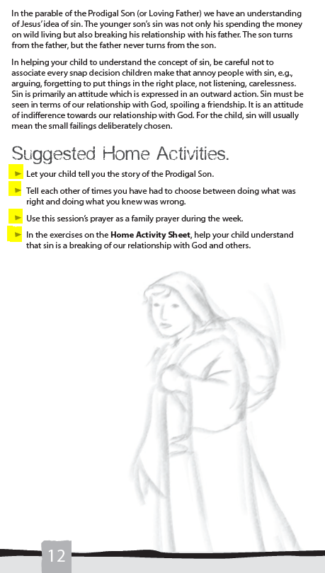
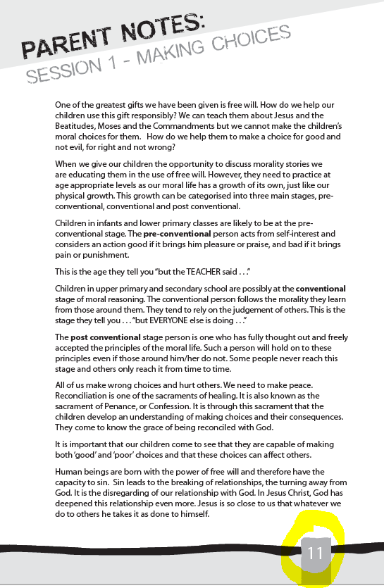
Suggested Home Activities
This program is designed so that the bookwork is completed during a one hour session time. In a sporting context this is the ‘game’.
During the week between sessions there should be time set aside for you to read the Parent Notes.
At the end of each of the PARENT NOTES there are suggested Home Activities. In a sporting context this is the ‘training’ between games.
Notes:
Who in your family plays a team sport. Being part of a team involves both the competition game and a training session. Sometimes organising the time to get to training during the week is more difficult than getting to the match on the weekend. Training is necessary – it is where you focus on the skills to play the game. Let’s think of the first part of each of these four sessions as the competition game and the home activity as the training session. It is easy to see why the first part is needed but why do you also need the home activity (training). The home activities help your child recall what was taught in each session and reinforces the main point of each session.

Slide 15
Home Activity
Sin is when we hurt others by our actions.
Discuss the three scenarios on page 13 with your child. By asking ‘who were the people that Justin, Fred and Jane did not care about’ you are helping your child see the consequence of an action. Who was hurt?
The Loving Father will help you and your child remember what Jesus taught. Read it together.

Slide 16
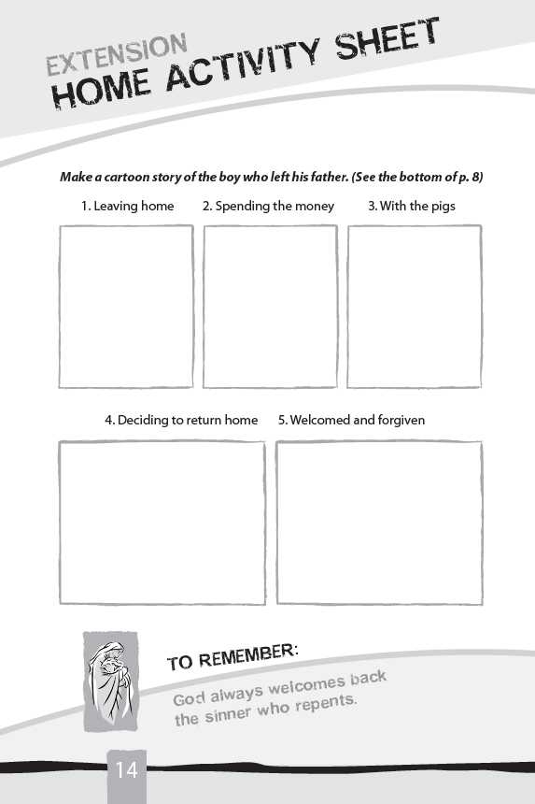
It always comes back to what did Jesus teach.
These pictures look at the process of reconciliation.
Leaving home – I want what I want now. I do not care about anyone else.
Spending the money – making foolish decision based on people who did not care about him.
No Money and feeding the Pigs – consequences of poor choices.
Deciding to repent– I wish I had not done this, who might help me?
Welcome home – there is nothing that is unforgivable if you want to be forgiven.
Notes:
It is said that a picture is worth a thousand words. Remember the first paintings your child drew when they were very little. How often did you need to ask very diplomatically who/what is that in your painting. Then you could see what the child was drawing in the picture. To the child the it is obvious – they drew it.
In this exercise, by asking your child to draw each of these scenes you should see what the words in the parable of the prodigal Son mean to them. The drawings will show how your child interprets the scripture story. In some cases you still may have to ask who is that in the picture and what are they doing.

Slide 17
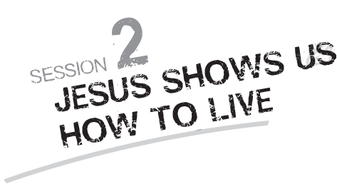
Next session

