Slide 1

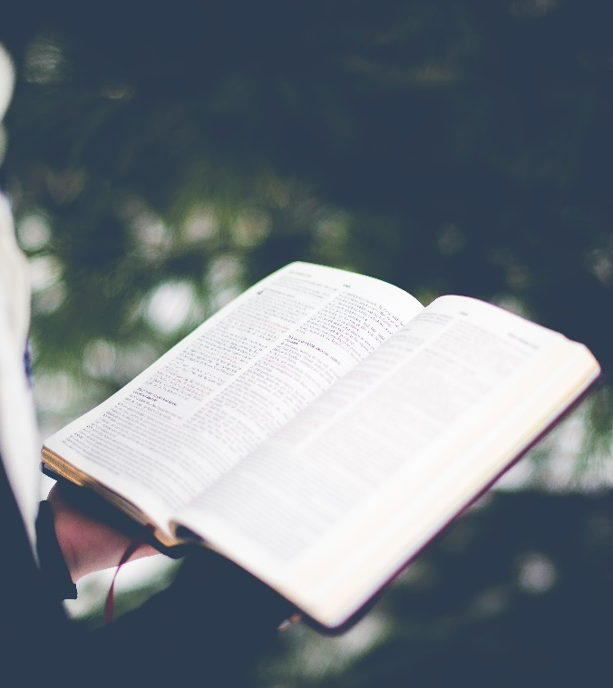

The Sacred Book
Notes:
Lesson aim: To experience the Bible as a sacred book which communicates God’s Word.

Slide 2
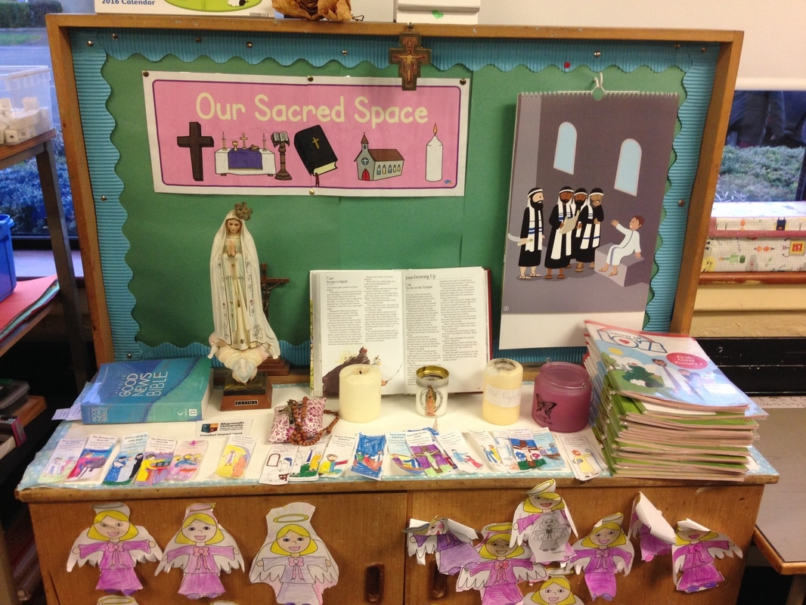
Notes:
It would be good to set up a sacred space with a cross, the Bible in the centre, a candle and rosary beads.

Slide 3
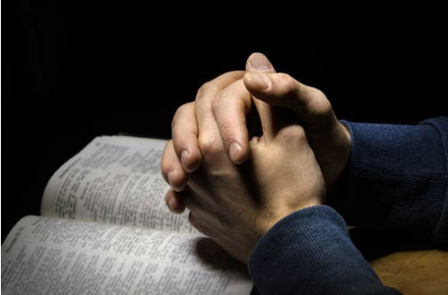
Our Father, who art in heaven, hallowed be thy name.
Thy kingdom come, thy will be done, on earth as it is in heaven.
Give us this day, our daily bread and forgive us our trespasses as we forgive those who trespass against us and lead us not into temptation but deliver
us from evil.
Amen.
Notes:
It would be good to set up a sacred space with a cross, the Bible in the centre, a candle and rosary beads.

Slide 4
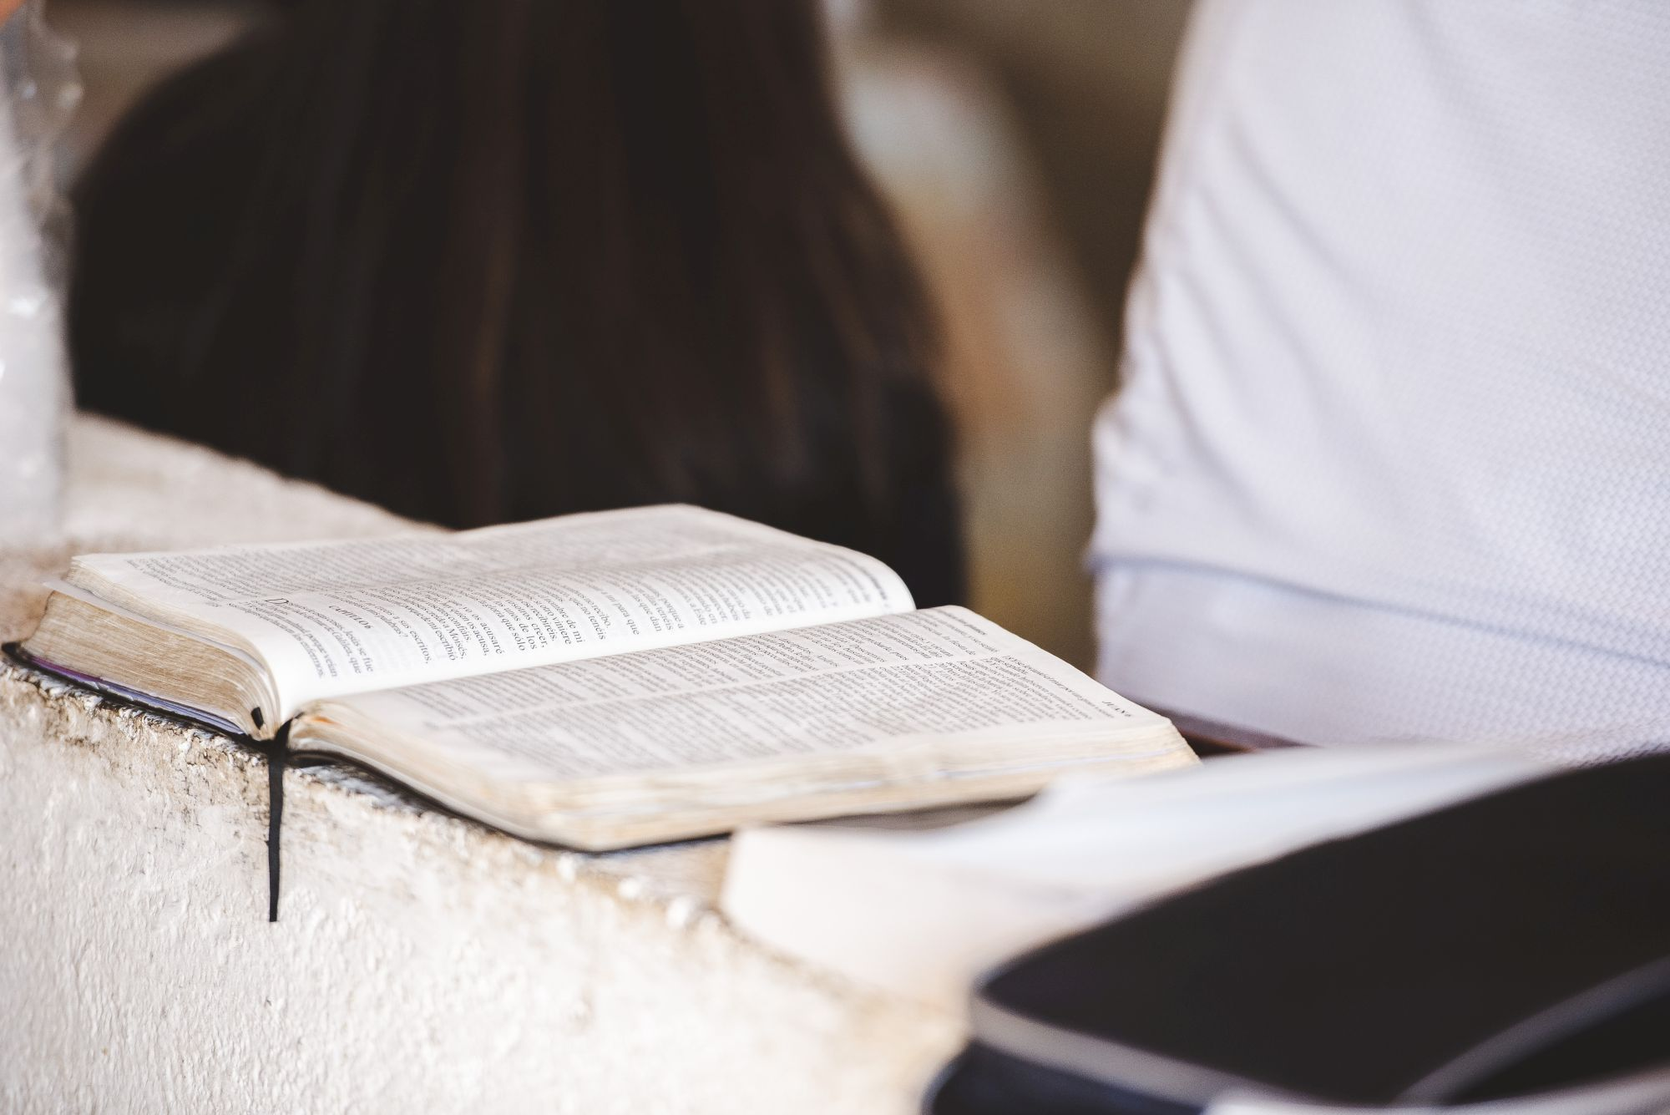
What do you think of when you hear the word “Sacred” or the phrase “Sacred Book”?
Notes:
Sacred book refers to the belief that certain books and the stories they contain relate to a
divine being. As such these books provide a holy access to God, an access that is not bound
by time and space. Jews, Christians and Muslims all hold their sacred books in high regard.
These books, the Torah, the Bible and the Koran, all revealing profound truths about God
and God’s relationship to people and people’s relationship with God and creation.
Christians believe that reading the Bible can actually be an encounter with God for it is
God’s word that we find in the Bible. God is not limited by time and space so we can relate
to God through what we call the sacred realm. The Bible is part of the sacred realm.

Slide 5
What does a Sacred Book contain?
Stories about important leaders or teachers in the religion
Stories about how the religion began
Advice about how to be a follower of the religion
Description of beliefs held by the followers of the religion
Laws or rules which people in the religion must follow
Notes:
A Sacred Book May Contain:
-Stories about important leaders or teachers in the religion
-Stories about how the religion began
-Advice about how to be a follower of the religion
-Description of beliefs held by the followers of the religion
-Laws or rules which people in the religion must follow
Does the Bible contain these?

Slide 6
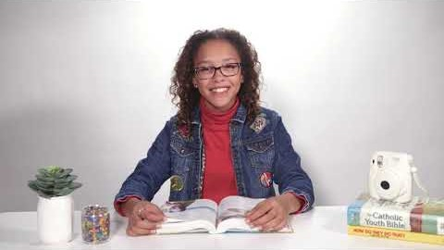
How Do I find a Bible Verse?
Notes:
Our next activity requires you to look up bible verses using your Bible. But the Bible is not a dictionary where you can look it up in alphabetical order. So then how do we find a bible verse? Watch this video to learn how.

Slide 7
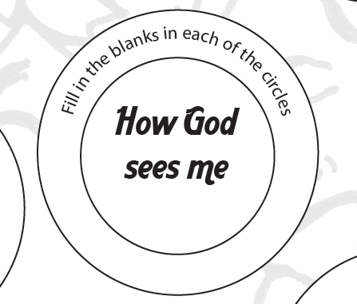
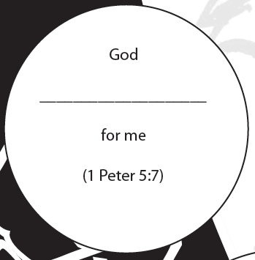
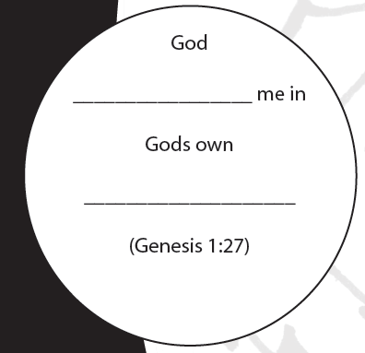
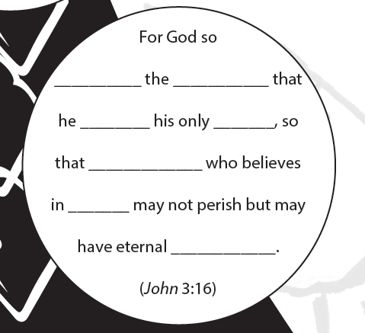
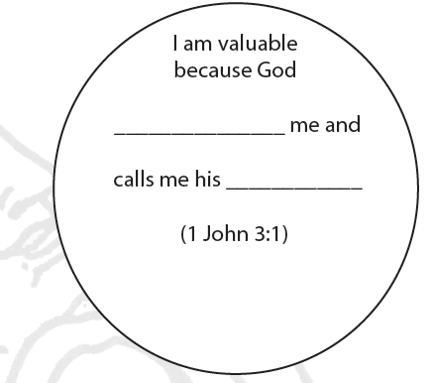

Notes:
I now invite you to enter the sacred realm of the Bible to discover what God and Jesus has to say to you.
Open you bible and look up the bible quotes on this slide. Read the verse, write it down in your journal while filling in the blanks, and interpret what it means to you.
When you are done, click on the slide and we’ll fill in the blanks together.

Slide 8
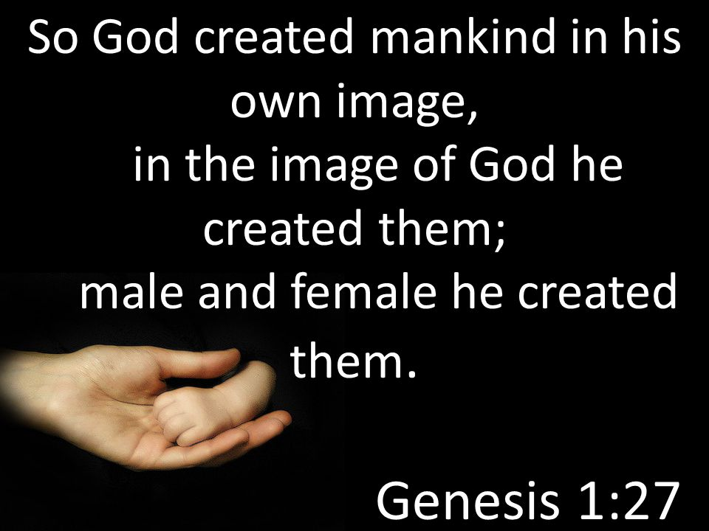
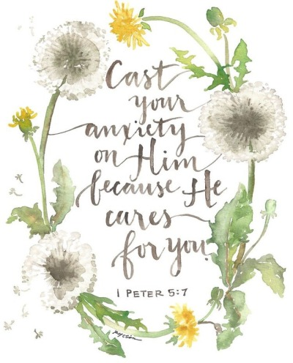
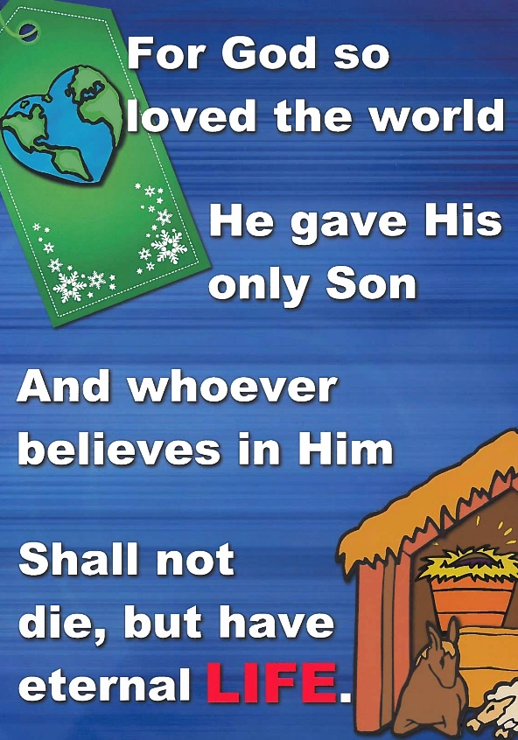
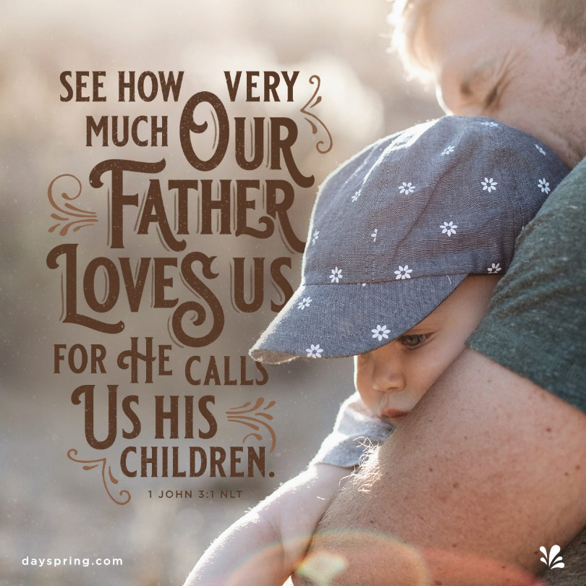
Notes:
Answers to the blanks

Slide 9
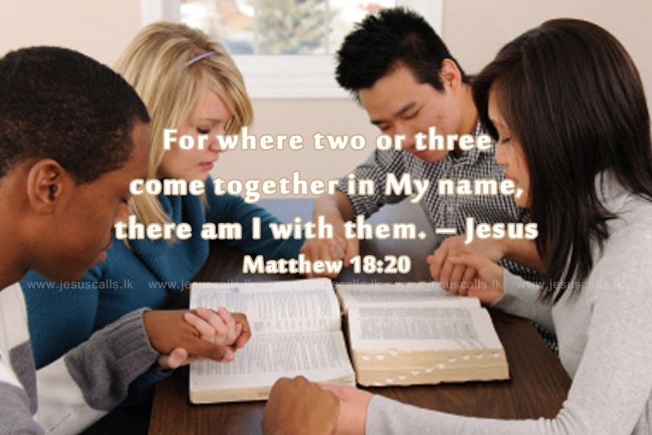
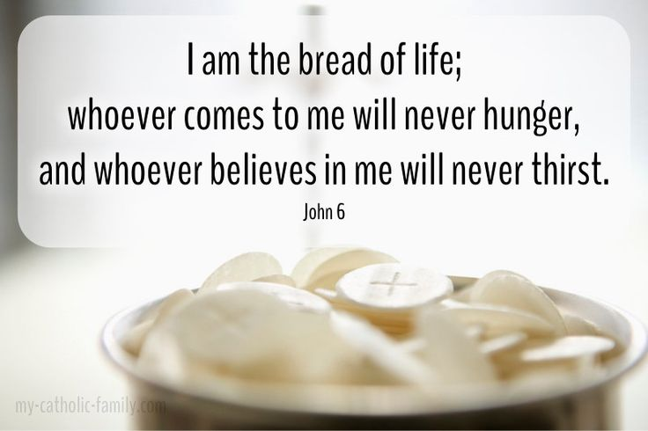
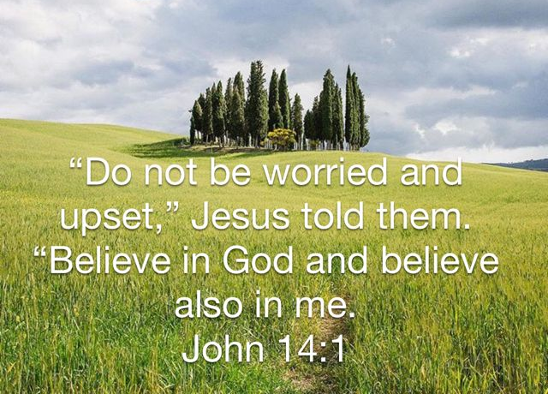
What Jesus Says:
Notes:
What does Jesus say?
He says: …
Choose some of your favourite bible quotes and write them down in your journal.

Slide 10
Concluding prayer:
Today we celebrate the sacred book we call the Bible.
We thank God for giving us this precious book.
Let us listen to God speak to us through the words of our holy book.
Proclaim your chosen quotes!

Slide 11
The ancient words of the Bible continue to reveal God to us today.
May we always know the real value of God’s word in our lives.
May we turn to the Bible often as we seek to know God and understand the purpose of our lives.
We offer this prayer through Jesus Christ our Lord.
Amen

Slide 12
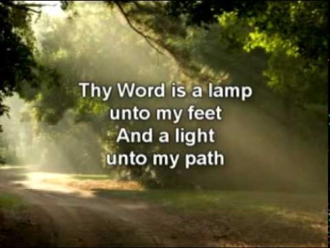

Slide 13
References
What is the Bible? Youtube video https://thebibleproject.com/videos/what-is-bible/
Sacred space image: https://www.scoilmhuireleixlip.net/sacred-space.html
‘Thy Word’ Lyric Youtube Video https://www.youtube.com/watch?v=O9VKSBForJY
‘Living Word of God’ Jeremy Camp lyric Youtube video https://www.youtube.com/watch?v=8xZYJ7NCbFE
Images
https://www.pinterest.com.au/pin/290271138473790431/
https://www.pinterest.ch/pin/190980840427018054/
http://ponderouspondering.blogspot.com/2015/07/18th-sunday-in-ordinary-time-b.html
https://comingtolight.org/verses-of-affirmation/
https://www.cefireland.com/wp-content/uploads/2015/12/For-God-so-Loved-the-World-Song.jpg
https://slideplayer.com/slide/6142339/
Script and Narration by Christine Jap

